Slide 1
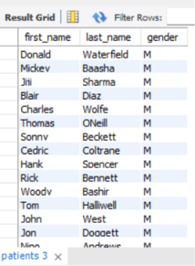
1. Show first name, last name, and gender of patients who's gender is 'M'
select first_name,last_name,gender
from patients
where gender = 'M';

Slide 2
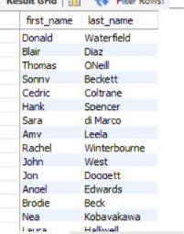
2. Show first name and last name of patients who does not have allergies.
select first_name,last_name
from patients
where allergies is null;

Slide 3
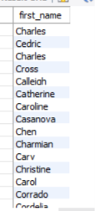
3. Show first name of patients that start with the letter 'C'
select first_name
from patients
where first_name like 'C%';

Slide 4
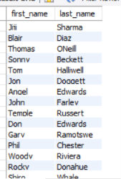
4. Show first name and last name of patients that weight within the range of 100 to 120 (inclusive)
select first_name,last_name
from patients
where weight between 100 and 120;

Slide 5
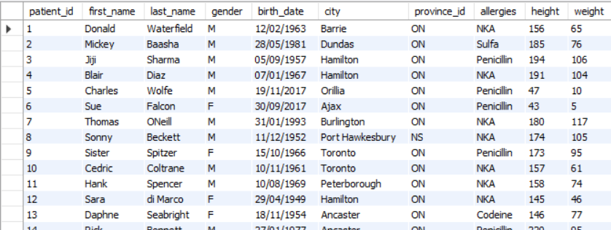
5. Update the patients table for the allergies column. If the patient's allergies is null then replace it with 'NKA'
update patients
set allergies='NKA’
where allergies is null;

Slide 6
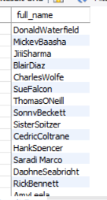
6. Show first name and last name concatenated into one column to show their full name.
select concat(first_name,last_name) as full_name
from patients;

Slide 7
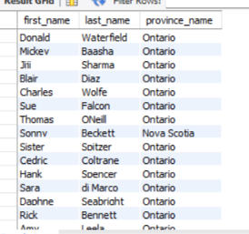
7. Show first name, last name, and the full province name of each patient.
select first_name,last_name,province_name
from patients
Join province_names on patients.province_id=province_names.province_id;

Slide 8

8. Show how many patients have a birth_date with 2010 as the birth year.
select birth_date
from patients
where year(birth_date)=2010;

Slide 9
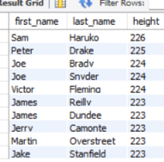
9. Show the first_name, last_name, and height of the patient with the greatest height.
select first_name,last_name,height
from patients
order by height desc
limit 10;

Slide 10
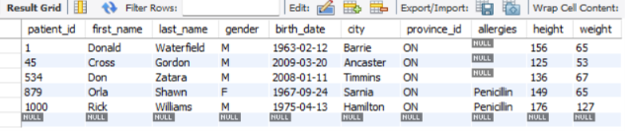
10. Show all columns for patients who have one of the following patient_ids: 1,45,534,879,1000
select * from patients
where patient_id in (1,45,534,879,1000);

Slide 11

11.Show the total number of admissions
select count(*) from admissions;

Slide 12

12. Show all the columns from admissions where the patient was admitted and discharged on the same day.
select * from admissions
where admission_date =discharge_date;

Slide 13

13.Show the total number of admissions for patient_id 579.
select count(*) from admissions
where patient_id =579;

Slide 14
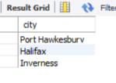
14. Based on the cities that our patients live in, show unique cities that are in province_id 'NS'?
select distinct city
from patients
where province_id='NS';

Slide 15
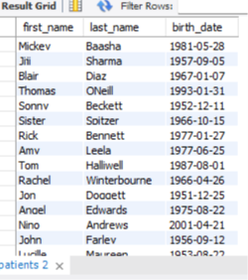
15. Write a query to find the first_name, last name and birth date of patients who have height more than 160 and weight more than 70
select first_name,last_name,birth_date
from patients
where height > 160
AND weight > 70;

Slide 16
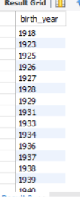
16. Show unique birth years from patients and order them by ascending.
select distinct year(birth_date) AS birth_year
from patients
order by birth_year ASC;

Slide 17
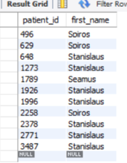
17. Show unique first names from the patients table which only occurs once in the list.
select patient_id,first_name
from patients
where first_name like 's%s’
And length(first_name)>=6;

Slide 18
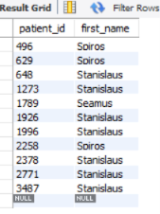
18. Show patient_id and first_name from patients where their first_name start and ends with 's' and is at least 6 characters long.
select patient_id,first_name
from patients
where first_name like 's%s’
And length(first_name)>=6;

Slide 19
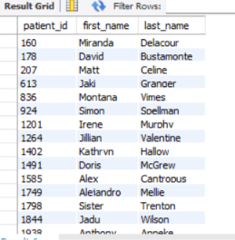
19. Show patient_id, first_name, last_name from patients whos diagnosis is 'Dementia'. Primary diagnosis is stored in the admissions table.
select p.patient_id,p.first_name,p.last_name
from patients p
join admissions a ON p.patient_id=a.patient_id
where a.diagnosis='Dementia';

Slide 20
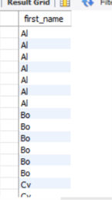
20. Display every patient's first_name. Order the list by the length of each name and then by alphbetically.
select first_name
from patients
order by length(first_name),first_name;

Slide 21

21. Show the total amount of male patients and the total amount of female patients in the patients table. Display the two results in the same row.
select sum(gender='M') AS male_patients, sum(gender='F') AS female_patients
from patients;

Slide 22

22. Show the total amount of male patients and the total amount of female patients in the patients table. Display the two results in the same row.
select sum(gender='M')AS male_patients, sum(gender='F') AS female_patients
from patients;

Slide 23
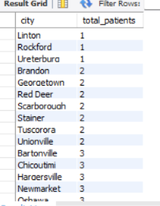
23. Show patient_id, diagnosis from admissions. Find patients admitted multiple times for the same diagnosis.
select patient_id, diagnosis
from admissionsgroup by patient_id, diagnosis
Having count(*) > 1 ;

Slide 24
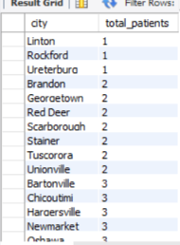
24. Show the city and the total number of patients in the city. Order from most to least patients and then by city name ascending.
select city , count(*) AS total_patients
from patients
group by city
order by total_patients ASC,city ASC;

Slide 25
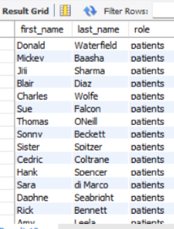
25. Show first name, last name and role of every person that is either patient or doctor. The roles are either "Patient" or "Doctor"
select first_name,last_name,'patients' AS role from patients
UNION ALL
select first_name,last_name,'doctor' AS role from doctors;

Slide 26
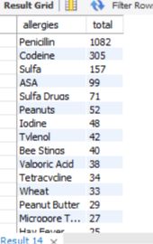
26. Show all allergies ordered by popularity. Remove NULL values from query.
select allergies, count(*) AS total
from patients
where allergies is not null
group by allergiesorder by total DESC;

Slide 27
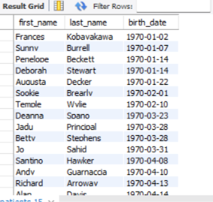
27. Show all patient's first_name, last_name, and birth_date who were born in the 1970s decade. Sort the list starting from the earliest birth_date.
select first_name,last_name,birth_date
from patients
where birth_date >= '1970-01-01’
AND birth_date < '1980-01-01’
order by birth_date ASC;

Slide 28

28. We want to display each patient's full name in a single column. Their last_name in all upper letters must appear first, then first_name in all lower case letters. Separate the last_name and first_name with a comma. Order the list by the first_name in decending order EX: SMITH,jane
select concat(upper(last_name),',',lower(first_name)) AS full_name
from patients
order by first_name DESC;

Slide 29

29. Show the province_id(s), sum of height; where the total sum of its patient's height is greater than or equal to 7,000.
select province_id,sum(height) AS total_height
from patients
group by province_id
having sum(height) >=7000;

Slide 30

30. Show the difference between the largest weight and smallest weight for patients with the last name 'Maroni'
select max(weight)-min(weight) AS weight_difference
from patients
where last_name='Maroni';

Slide 31
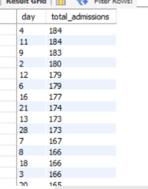
31. Show all of the days of the month (1-31) and how many admission_dates occurred on that day. Sort by the day with most admissions to least admissions.
select day (admission_date) as day,count(*) as total_admissions
from admissions
Group by day(admission_date)
order by total_admissions desc;

Slide 32
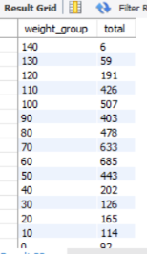
32. Show all of the patients grouped into weight groups. Show the total amount of patients in each weight group. Order the list by the weight group decending. e.g. if they weight 100 to 109 they are placed in the 100 weight group, 110-119 = 110 weight group, etc.
select floor(weight/10)* 10 as weight_group,count(*) as totalfrom patientsgroup by weight_grouporder by weight_group desc;

Slide 33
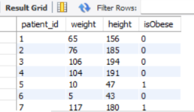
33. Show patient_id, weight, height, isObese from the patients table. Display isObese as a boolean 0 or 1. Obese is defined as weight(kg)/(height(m). Weight is in units kg. Height is in units cm.
select patient_id,weight,height,
case when weight / power(height/100.0,2)>=30 then 1 else 0 end as isObese
from patients;

